Slide 1
Statistical Anomaly Detection
M33P

Slide 2
Network Anomaly Detection
Detect abnormal activity on the network
Find malfunctioning network hardware
Detect data exfiltration & intrusion

Slide 3
Advancing the Field - My Approach
Compare some current Anomaly Detection methods
Improve upon methodologies to reduce false positives, find more anomalies
Use real world data

Slide 4
Definitions
Packet - chunked data that is transmitted over the network, reassembled at the destination
IP (address) - unique identifier each computer on the network has
Port - 1-65535 Numeric that combined with IP finishes the specific routing address for a given packet
Packet Size - the size the packet occupies in memory, in bytes
Packet Density (Rate) - How many packets are being transmitted in a given minute

Slide 5
setup
EC2 host running iptables
Perl parsing iptables logs into CSV, calculating Packet Rate
Each line in data represents single packet
R to process the data once in CSV format

Slide 6
General Data Info
Approximately 10 days of logs
Log format - 8 variables date, localhost, localport, remotehost, remoteport protocol, packet size, and packet rate
226,843 observations ~ 18 megabytes
Planted 4 anomalies ~ 2 in packet size, 2 in packet rate

Slide 7
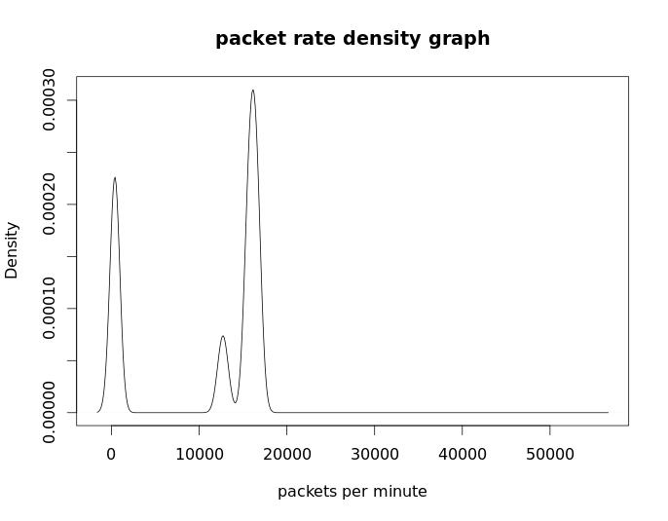
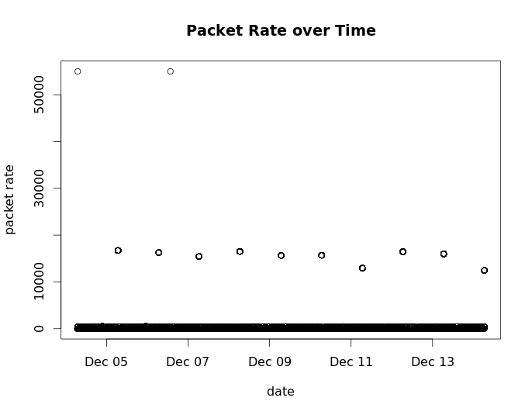
General Data Analysis

Slide 8
Standard Method
Used the mean & standard deviation of packet density to define expected levels
Mean of 10693 packets per minute in packet rate
SD of 7162 packets per minute in packet rate

Slide 9
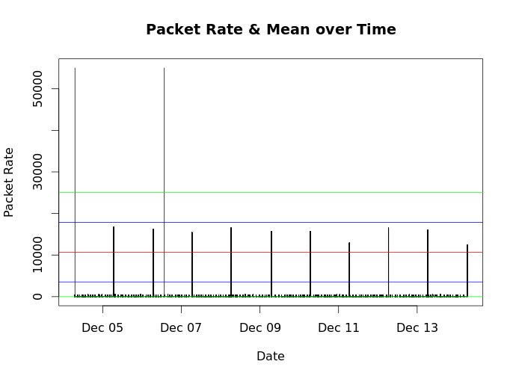
Standard Method
Red line is mean
Blue lines are one deviation
Green lines are two deviations or 0 (the minimum)

Slide 10
Standard Method - Results
Detected two anomalies
Will miss anomalies in the low end
Does not use packet size so missed all anomalies in that information
May include possible anomalous activity in the analysis, due to the original data’s high variability

Slide 11
Parametric method
Poisson distribution assumed to fit Packet Rate
Gaussian distribution models entropy of Packet Size
Determines likelihood ratios for each distribution
Flags when outside set threshold values of likelihood
Anomaly if both distributions flag

Slide 12
Parametric Method - Results
Six events flagged as anomalies – two sequences of time-categorical events 1 2013-12-04 06:48:38 10.239.25.140:1984 109.68.191.26:55349 TCP 40 2 2 2013-12-04 06:48:38 109.68.191.26:55349 10.239.25.140:1984 TCP 40 2 3 2013-12-04 06:50:01 10.239.25.140:61613 109.68.191.26:56823 TCP 40 2 4 2013-12-04 06:50:01 109.68.191.26:56823 10.239.25.140:61613 TCP 40 2 5 2013-12-04 06:52:55 10.239.25.140:69 46.38.48.66:39109 TCP 40 2 401 2013-12-04 07:01:52 82.94.251.204: 443 10.239.25.140:57913 TCP 52 397 402 2013-12-04 07:01:52 82.94.251.204:443 10.239.25.140:57913 TCP 52 397 403 2013-12-04 07:01:52 82.94.251.204:443 10.239.25.140:57913 TCP 52 397 404 2013-12-04 07:02:52 10.239.25.140:57913 82.94.251.204:443 TCP 52 2 405 2013-12-04 07:02:52 82.94.251.204:443 10.239.25.140:57913 TCP 638 55000

Slide 13
Linear Method
Allows us to use multiple factors to design expected values, as opposed to standard which can only examine one factor and variances inside that value
Basic model uses Protocol and Packet Size to predict Packet Density
From this construct the standard error distribution, and then calculate three deviations from the mean to define normal activity, rest anomalous

Slide 14
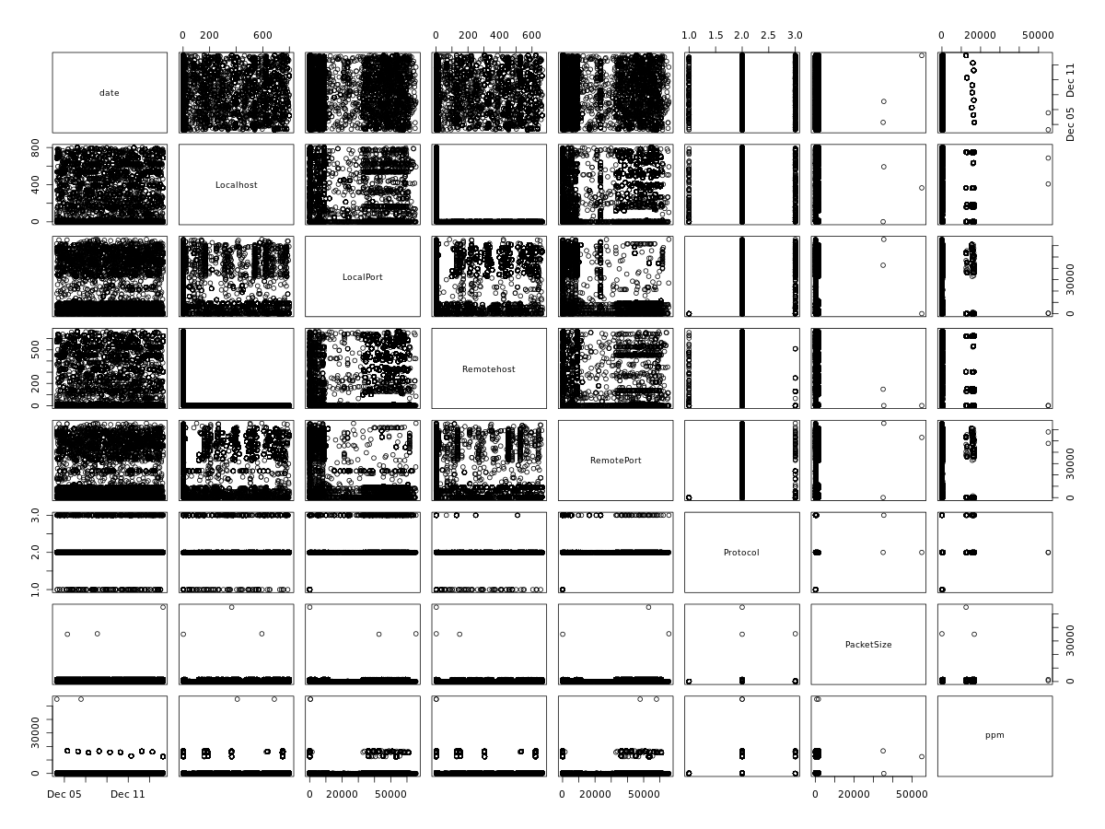

Slide 15
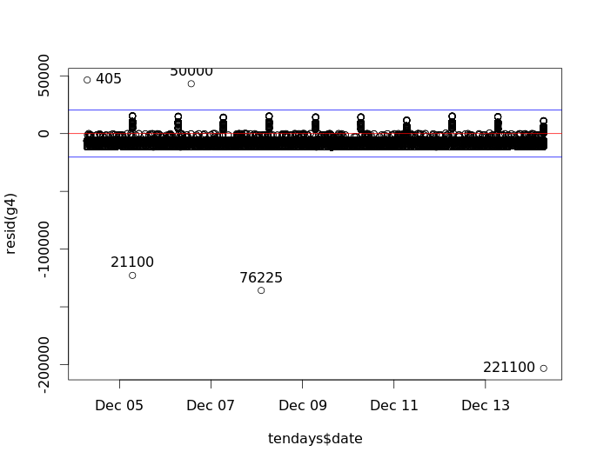
Linear Method
Found 5 anomalies
One was not planted (true anomaly) id 76225

Slide 16
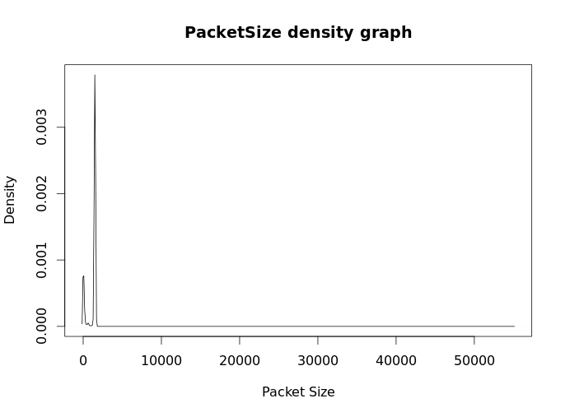
Linear Method - Anomaly Summary
76225 | 2013-12-08 02:21:28 | 61.133.87.115 | 65535 | 10.239.25.140 | 65535 | UDP | 35357 | 2
61.133.87.115 is from China(CN) in region Southern and Eastern Asia
Significant anomaly, not detected by standard or parametric methods
Implications significant

Slide 17
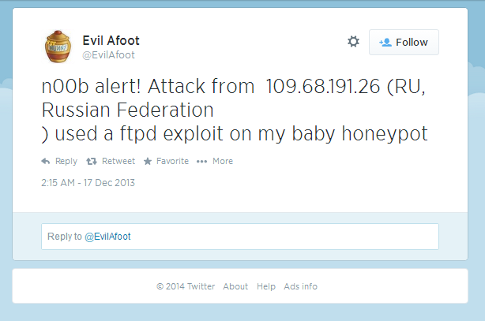
Further Analysis
Row # | Date | Localhost | LocalPort | Remotehost | Remote Port | Protocol | PacketSize | PacketRate
76222 | 2013-12-08 02:17:06 | 109.68.191.26 | 43344 | 10.239.25.140 | 143 | TCP | 40 | 5
76223 | 2013-12-08 02:17:22 | 10.239.25.140 | 513 | 109.68.191.26 | 43344 | TCP | 40 | 5
76224 | 2013-12-08 02:17:22 | 109.68.191.26 | 43344 | 10.239.25.140 | 513 | TCP | 40 | 5
76225 | 2013-12-08 02:21:28 | 61.133.87.115 | 65535 | 10.239.25.140 | 65535 | UDP | 35357 | 2
76226 | 2013-12-08 02:33:15 | 10.239.25.140 | 993 | 109.68.191.26 | 43344 | TCP | 40 | 4
76227 | 2013-12-08 02:33:15 | 109.68.191.26 | 43344 | 10.239.25.140 | 993 | TCP | 40 | 4
109.68.191.26 is from Russian Federation(RU) in region Eastern Europe

Slide 18
Linear Method - Summary
Graphically resource intensive
Requires mathematical knowledge to design model
Hard to model network traffic
Network traffic does not meet assumptions of the model
Even bad models can provide good results

Slide 19
Comparison of Methods
All three models have some value
Very low false positive rate amongst them all in these cases
Standard method has severe limitations
Parametric method tailored to DDOS detection
Linear caught the most anomalies

Slide 20
Conclusions
Anomaly detection has many options, growing field
Systems are being geared toward specific type of detection, so may require multiple versions of anomaly detection running in layers to catch all
All methods I tested can be run in real time on live data

Slide 21
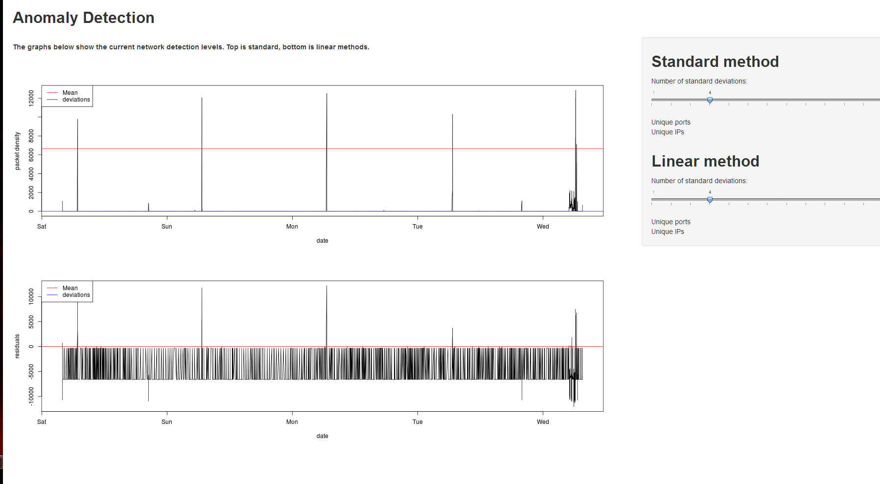
Real-time Analysis
Code available for realtime version of linear & stdev models at http://github.com/m33pz/anomaly-detection/

Slide 22
References
Chandola, V., Banerjee, A., and Kumar, V. 2009. Anomaly detection: A survey. ACM Comput. Surv. 41, 3, Article 15, 58 pages. July 2009. http://doi.acm.org/10.1145/1541880.1541882
Julian J. Faraway, Linear Models with R. Chapman & Hall/CRC Press; 2005
Mai, J., Chuah, C. N., Sridharan, A., Ye, T., & Zang, H. Is sampled data sufficient for anomaly detection?. In Proceedings of the 6th ACM SIGCOMM conference on Internet measurement (pp. 165-176). ACM. October 2006. http://www.cse.cuhk.edu.hk/~cslui/CSC7221/imc2006_samplinig_enough.pdf
Kaleton Internet, Combination of Misuse and Anomaly Network Intrusion Detection Systems. PacketStormSecurity.net. March 2002. http://dl.packetstormsecurity.net/papers/IDS/kaletonidspaper.pdf
David M. Nicol, Michael Liljenstam, and Jason Liu. Advanced concepts in large-scale network simulation. In Proceedings of the 37th conference on Winter simulation (WSC '05). Winter Simulation Conference 153-166. 2005. http://dl.acm.org/citation.cfm?id=1162740

Slide 23
Questions?

